Slide 1
Introduction to Social Media Analytics (Lec 9)
Hao PENG
Department of Data Science
City University of Hong Kong
https://haoopeng.github.io/

Slide 2

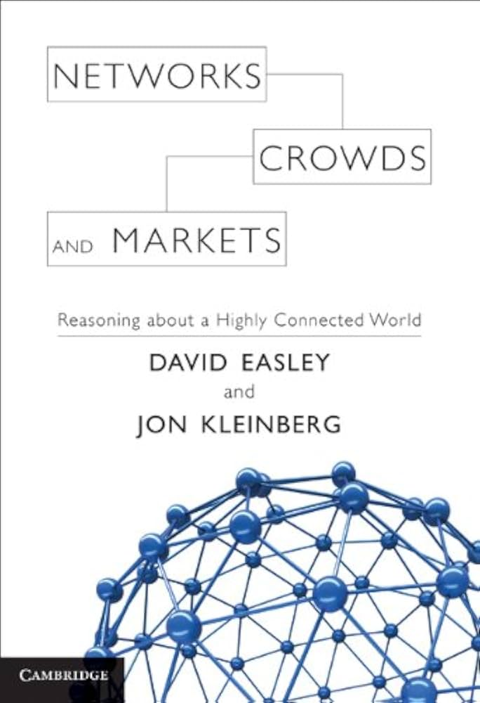
Network Science
Network science studies numerous real-world complex networks to understand their statistical properties, structure, and dynamics.
Related areas: graph theory, statistics, mathematics, control theory
Common examples include social networks, information networks, transportation networks, biological networks, transaction networks.
We will focus on social and information networks in this class.

Slide 3
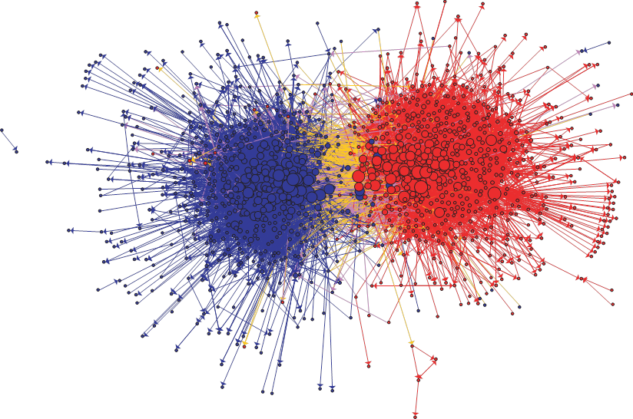
Information networks
Communication between left-wing and right-wing political blogs (Adamic and Glance)

Slide 4
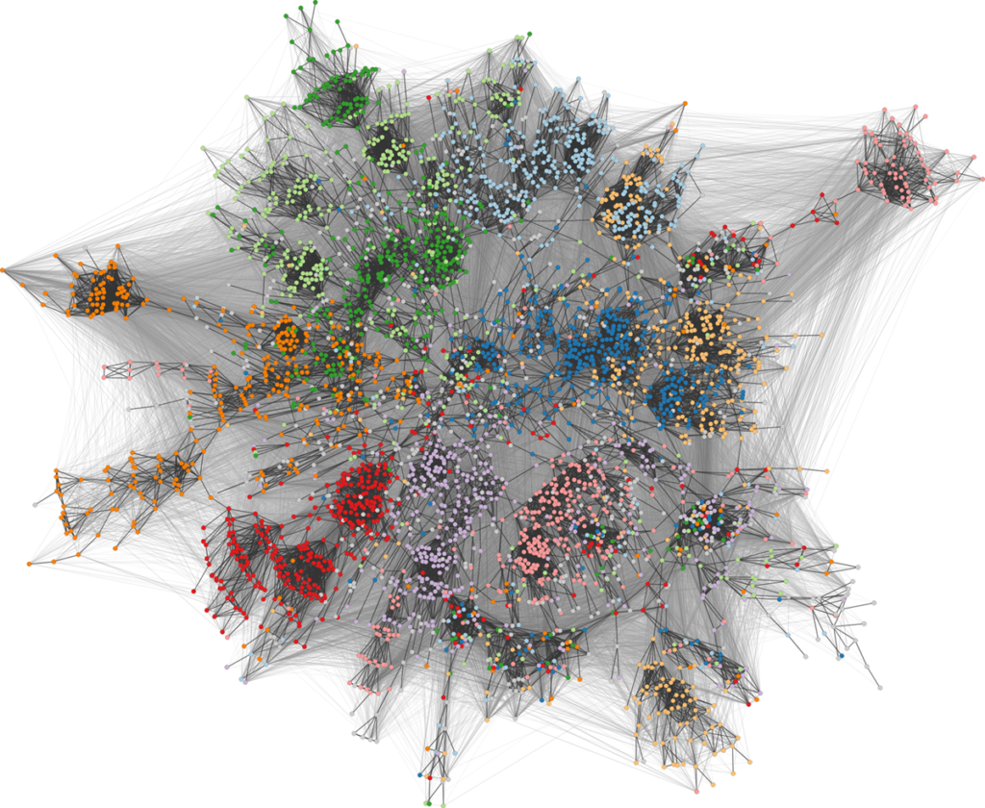
Social networks
Facebook network of university students (color shows dormitory)

Slide 5
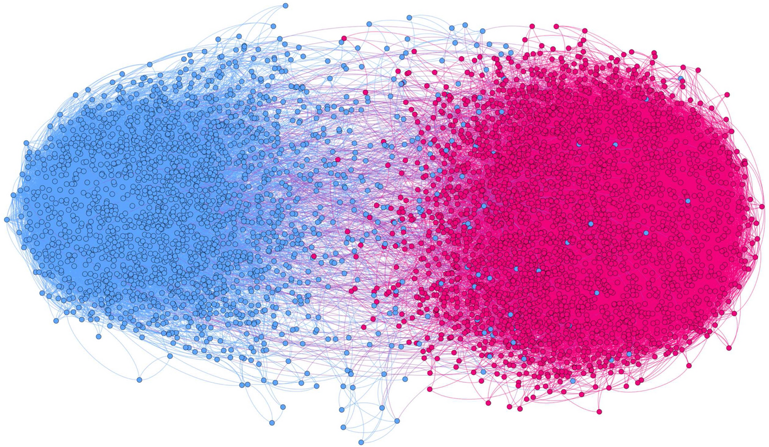
Social networks
The largest component of a polarized retweet network on Twitter based on political hashtags (only enable to show nodes with k-core above 3 here).
That’s why we need statistical analysis, models, and algorithms to understand the complex structure of large social networks!
https://link.springer.com/article/10.1007/s42001-020-00084-7

Slide 6
Network definition & vocabulary
A representation of connections among a set of items.
Items are called nodes (vertices)
Connections are called edges (or link or ties)
G
A
Different types of networks:
Undirected, directed
Weighted, unweighted
Connected, disconnected
B
C
F
D
Edge
E
Node

Slide 7
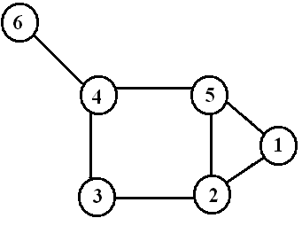
Degree of nodes
Number of edges incident on a node
The degree of node i: d(i)
d(6) = 1
d(4) = 3
d(5) = 3
d(1) = 2
d(3) = 2
d(2) = 3

Slide 8
Basic features of social networks
Short average distance
Strong and weak ties
Community structure
Social influence and hubs
And many more….

Slide 9
How to find influential nodes
Which nodes are the most important?
Suppose you are going to give away free tickets to your show
Who should you give them too?
Suppose you can pay someone to TikTok about your product
Who should you pay?
Suppose you want to be elected to a position
Whose endorsement will help you the most?
Notes:
Maybe because viral information is initially started by important nodes in the network.

Slide 10
Measures of node centrality
Degree centrality
PageRank centrality
Betweenness centrality
…
Which is best depends on the problem you are studying.
Notes:
To identify influentials

Slide 11
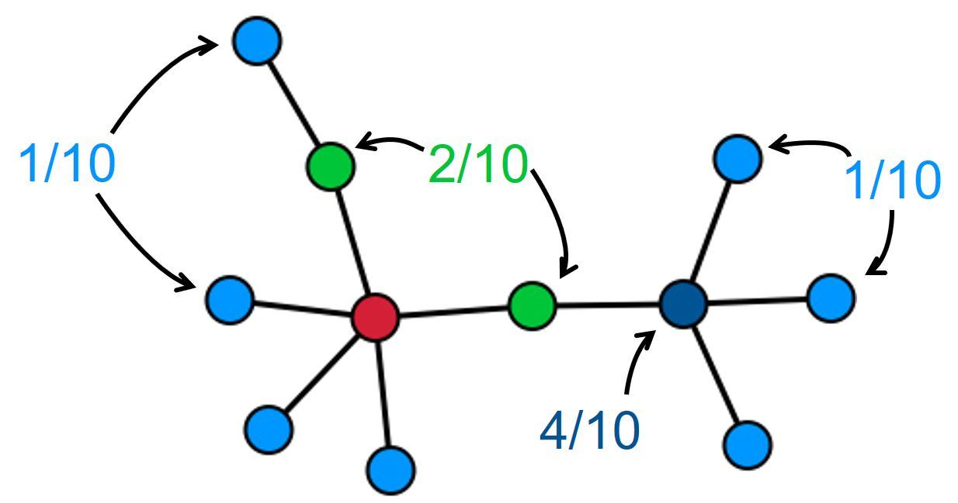
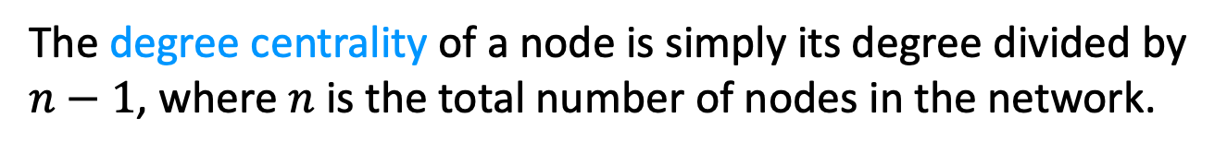
Degree centrality
The degree centrality of a node is simply its degree divided by $n−1$, where $n$ is the total number of nodes in the network.
When would this be a good measure of influence?
When/why might it not be a good measure of influence?
Notes:
For popularity
For scientific impact (citation): hard to rank papers with the same citation count. A citation from Nature may be more important than others.

Slide 12
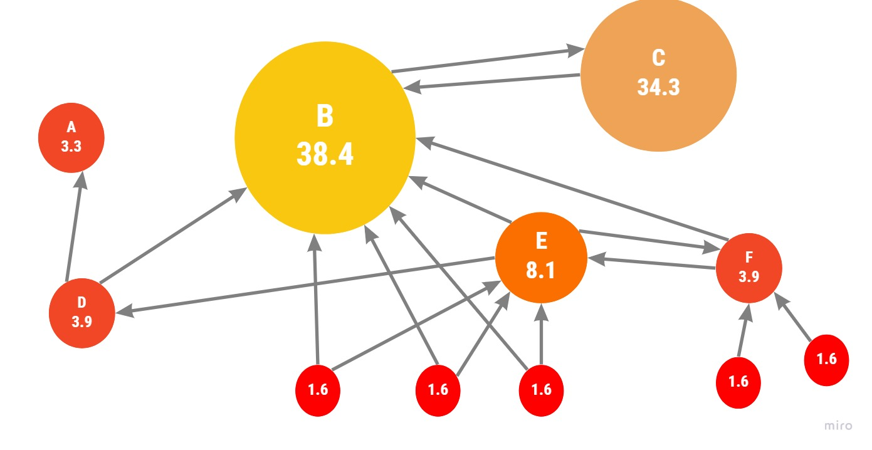
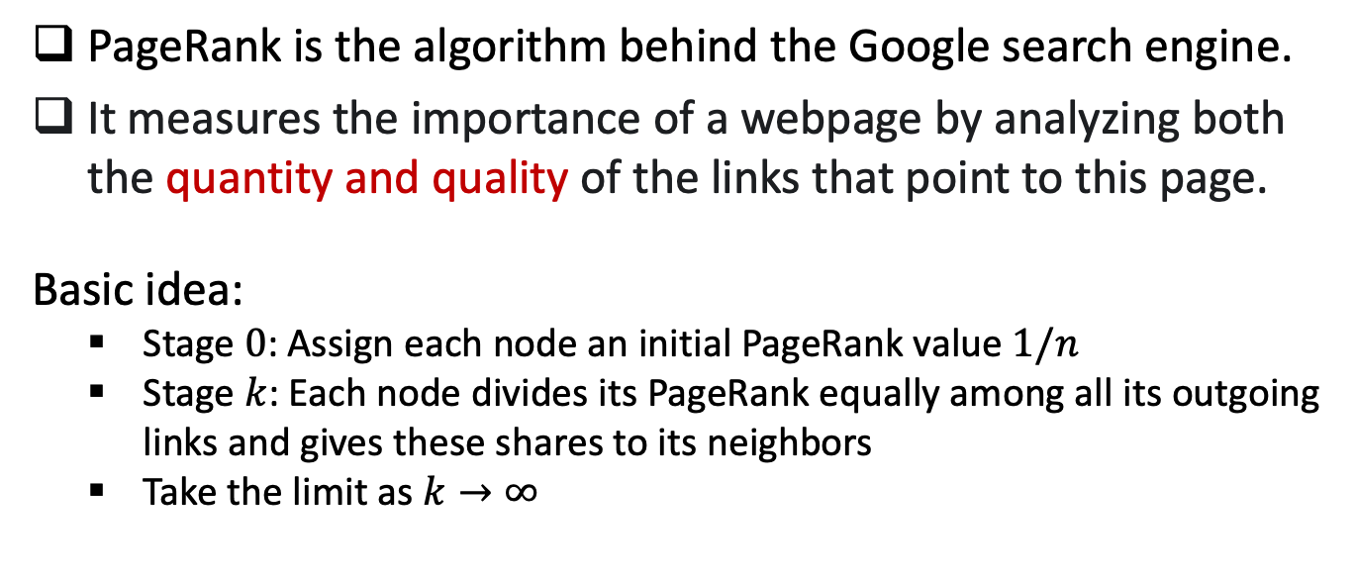
PageRank algorithm
PageRank is the algorithm behind the Google search engine.
It measures the importance of a webpage by analyzing both the quantity and quality of the links that point to this page.
Basic idea:
Stage $0$: Assign each node an initial PageRank value $1/n$
Stage $k$: Each node divides its PageRank equally among all its outgoing links and gives these shares to its neighbors
Take the limit as $k→∞$

Slide 13
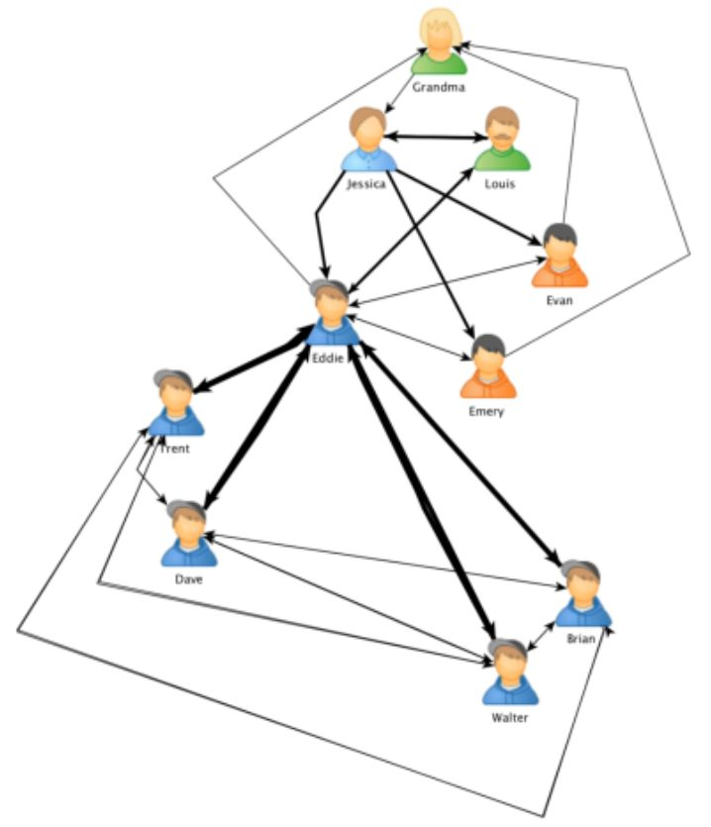
Betweenness centrality
The betweenness centrality of a node is calculated as the number of shortest paths of all pairs of nodes that pass through that node. It can measure the importance of nodes connecting different communities.
Notes:
Nodes with high betweenness centrality scores are often called “broker”
Broker plays a crucial role in exchanging information between communities
Computation is very costly

Slide 14
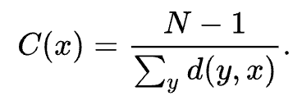
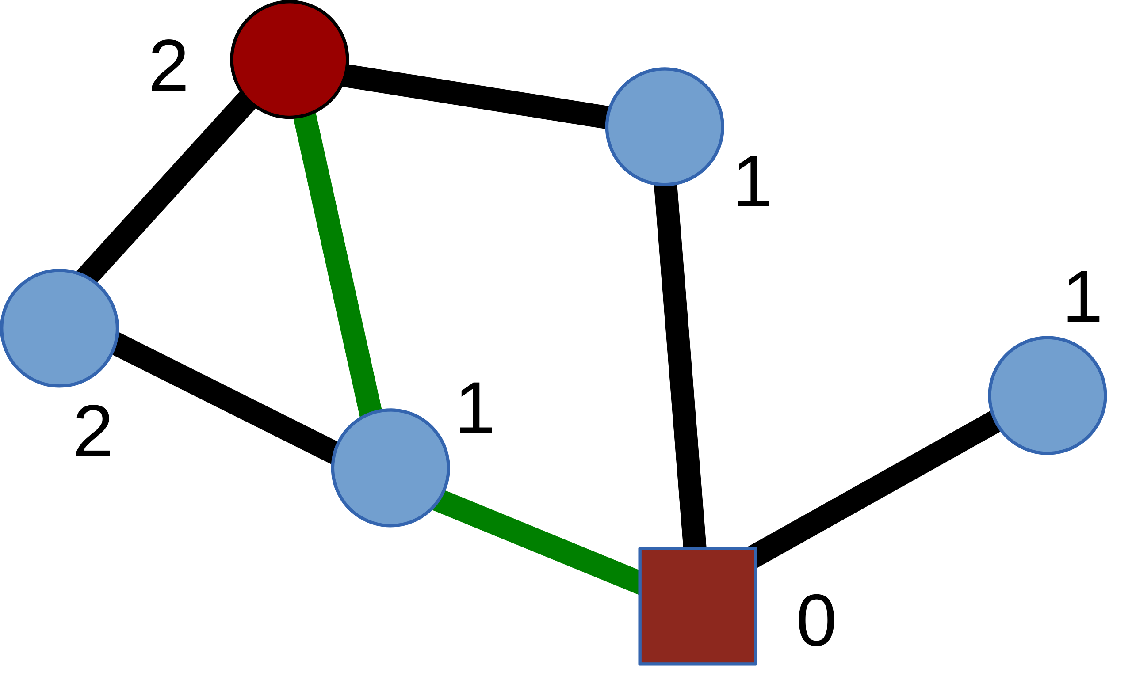
Closeness centrality
The closeness centrality of a node is calculated as the inverse of its avg shortest distance between the node and all other nodes in the network. The more central a node is, the closer it is to all other nodes.
The green edges illustrate one of the two shortest paths between the red square node and the red circle node.
Closeness of the square node: 5/(1+1+1+2+2) = 5/7

Slide 15
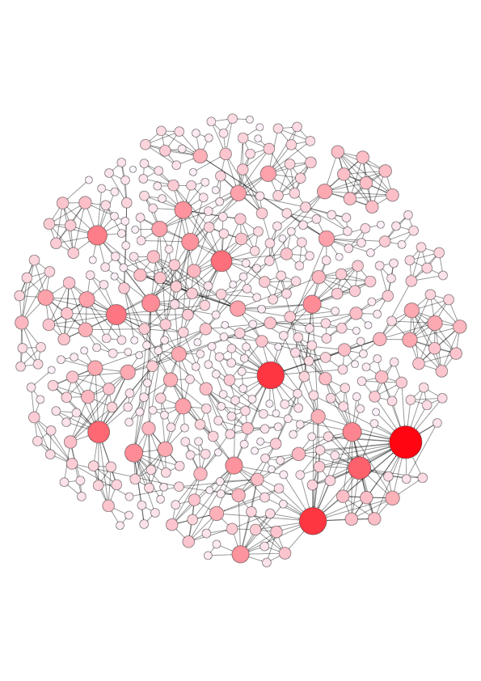
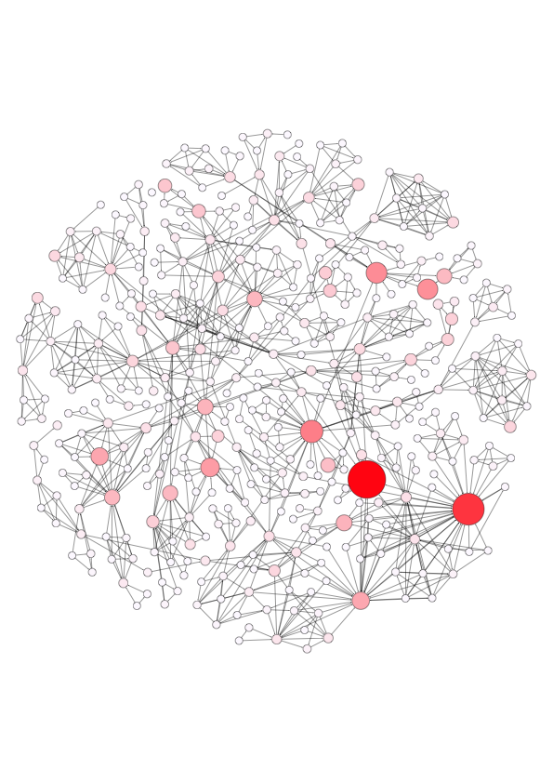
Comparing different measures
Degree centrality
PageRank
In what social scenarios should we use degree centrality?
What about the PageRank centrality? Give real examples.
Notes:
Important nodes identified by PR are quite different from that identified by DC.

